Slide 1

Product Recommendation System
Harianth Kumar Kancharla
Likhitha Gupta Thallapally
Pavani Billapati
Trilok Kumar Pidikiti

Slide 2

Vision Statement
Building recommendation system for products on an e-commerce website like Amazon, Flipkart and many more.

Slide 3
Approach..
Predicting the products, based ratings a user might have given to a specific item.
These ratings will then be ranked and are used to predict the most suitable products.

Slide 4

Recommendation systems
Is an artificial intelligence algorithm, usually associated with machine learning, that uses Big Data to suggest or recommend additional products to consumers.

Slide 5
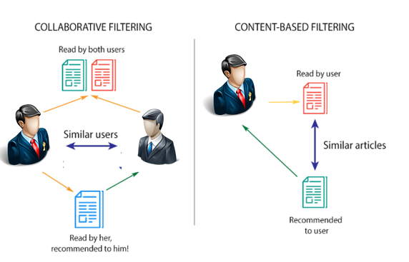
In this project we have adopted collaborative filtering.
Collaborative filtering scales to massive datasets and produces high quality recommendation in real time.
This project is influenced by amazon’s recommendation system.
Rated by Similar Users
Rated by Similar Users
User 1
Purchased by User 1, recommended to similar users
Product Recommendations

Slide 6
Collaborative Filtering
Memory Based
Model Based
Uses user rating historical data to compute the similarity between users or items.
Uses machine learning algorithms to predict users’ rating of unrated items.

Slide 7
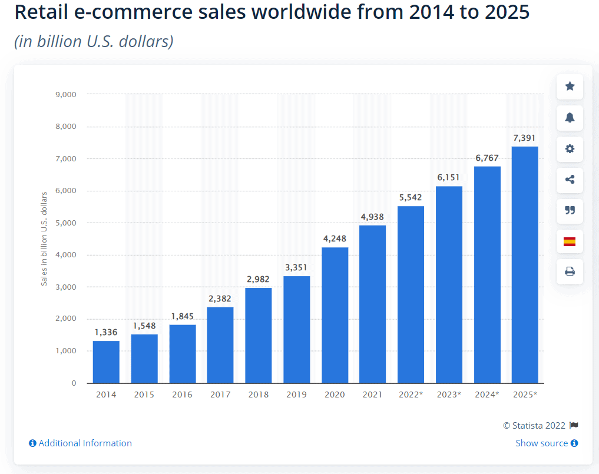
Statistics

Slide 8
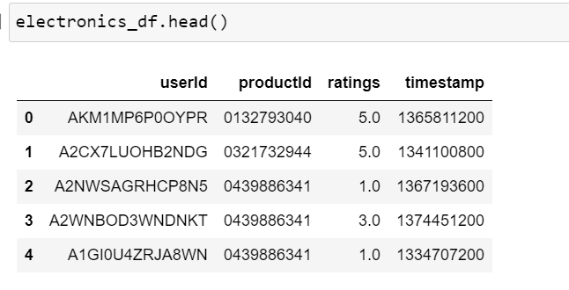
Data Set
Source – Amazon Dataset Page
It contains 4 Features with around 80 million rows.

Slide 9
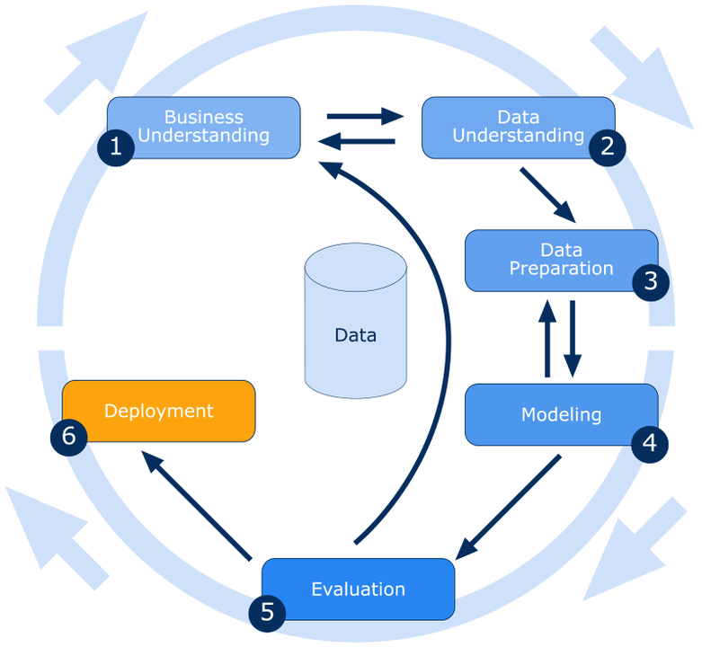
Methodology

Slide 10






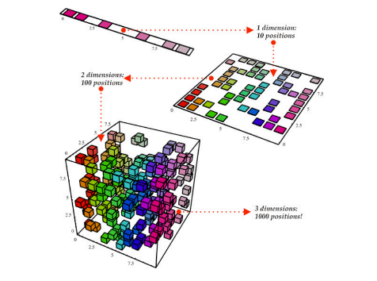




Pipeline
Capture
Process
Analyze
Model Building
Deployment

Slide 11
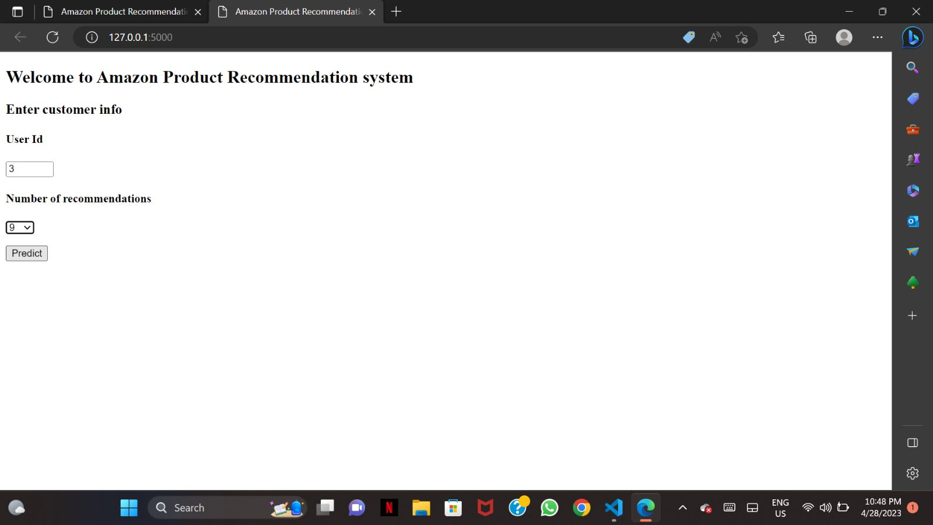
Input

Slide 12
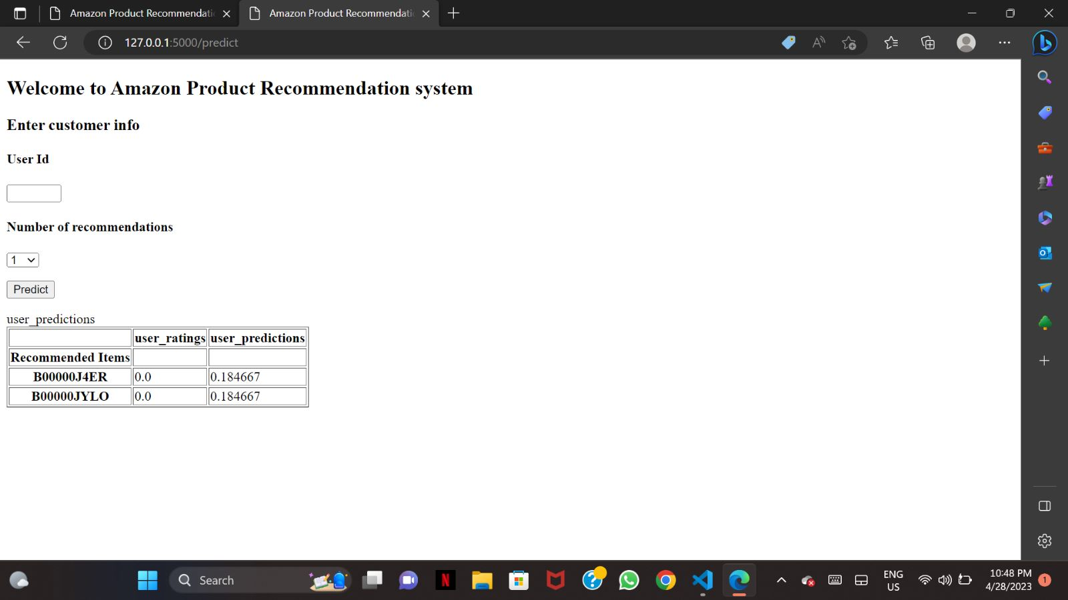
Output

Slide 13
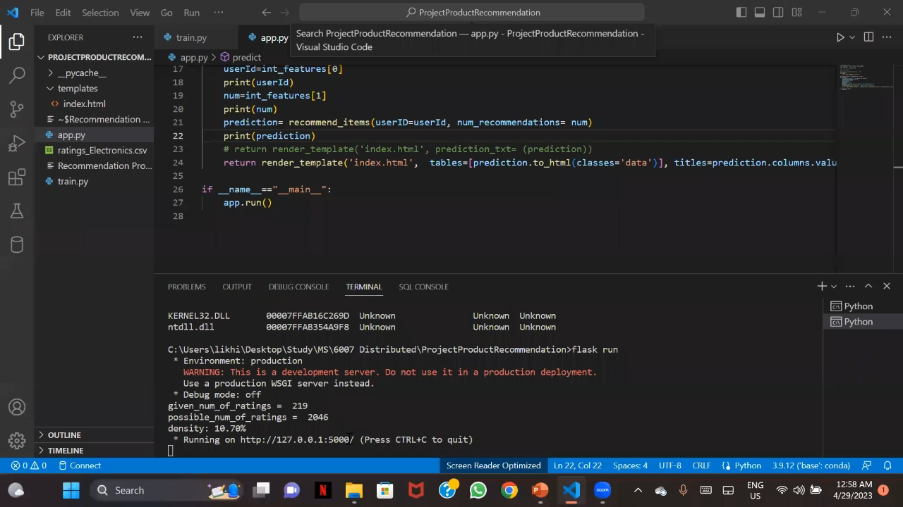

Slide 14
Value Added
Customer’s perspective
Provides a better overall personalized experience for customers.
Helps to narrow down customer search from a wide range of choices by suggesting relevant items
Company’s perspective
Helps in marketing products based on customer’s interest, eventually increases the rate of purchase.
Help deliver their items to the right user.

Slide 15
Thank You

